Slide 1
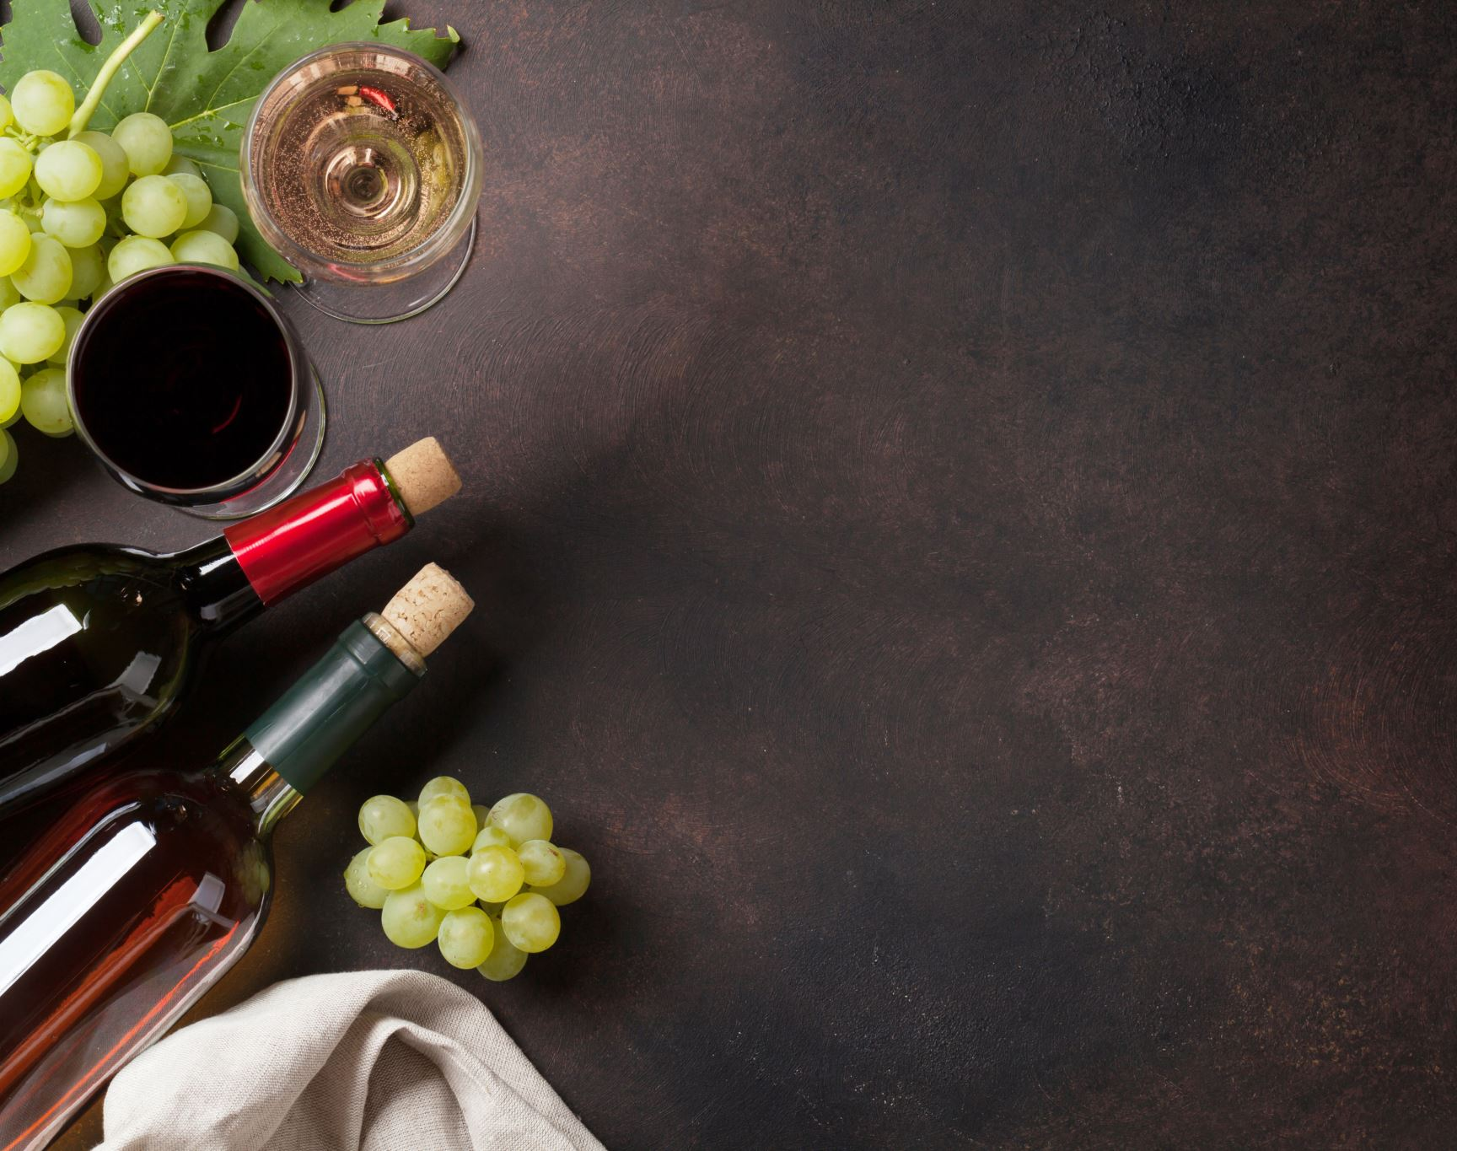
Wine Quality Prediction

Slide 2
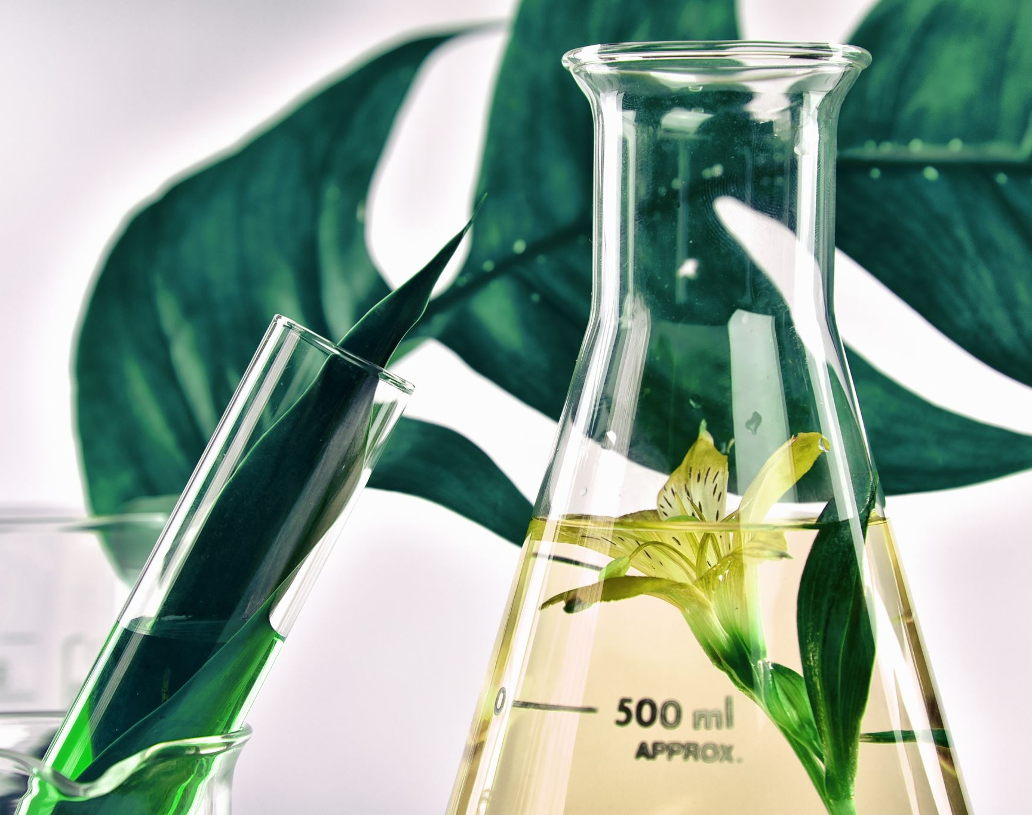
PRESENTERS Ashwanth ram A C -CB.EN.U4CCE21009 Gautam R S -CB.EN.U4CCE21020 Dhanush raj S -CB.EN.U4CCE21015 Harini raj R G -CB.EN.U4CCE21026

Slide 3
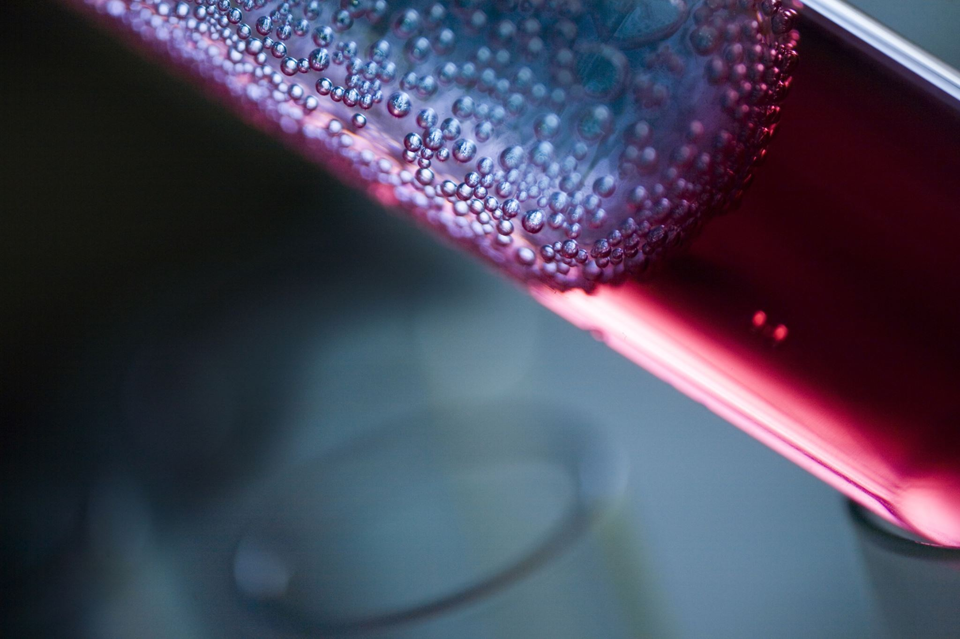
Introduction
Wine quality prediction involves analyzing the chemical composition, sensory properties, and other relevant attributes of a wine to determine its overall quality or rating. It combines objective measurements, such as acidity and sugar levels, with subjective assessments, including aroma and taste evaluations, to estimate the wine's quality. Machine learning and statistical modeling techniques are commonly used to train algorithms on large datasets, enabling accurate predictions based on factors such as grape variety, winemaking techniques, region, and vintage. Wine quality prediction provides valuable insights for producers, distributors, and consumers, facilitating informed decision-making and enhancing the overall wine experience.

Slide 4

METHODOLOGY
In this method, we begin by acquiring a dataset and subsequently utilize machine learning methods to preprocess the data, replace the missing values by mean and also finding out the outliers and replacing it by its mean. This helps in simplifying the data by reducing its complexity. Next, we apply Logistic Regression Algorithm, Decision Tree, Random Forest Algorithm, KNN Classifier, Support Vector Machine and Naive Bayes Classification algorithms to the processed dataset. By considering the characteristics of the dataset, we make predictions. And we compare all the algorithms and get their accuracy level. With this we come to a conclusion that, which algorithm suits the best for this model. And the predictions inform us whether the quality of the wine is good or bad.

Slide 5

Summarized Results

Slide 6
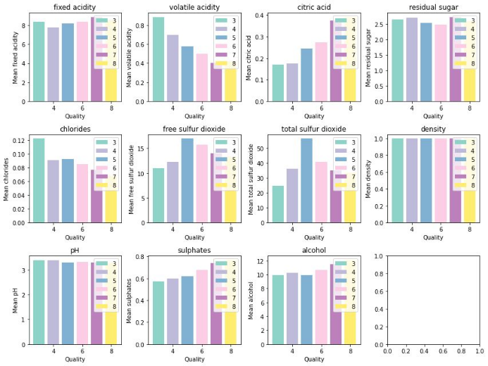
These subplots were generated, in which each subplot represents the mean values of a different feature grouped by the quality ratings in the 'wine' Data Frame. It provides a visual comparison of the mean values across different quality ratings for each feature.

Slide 7
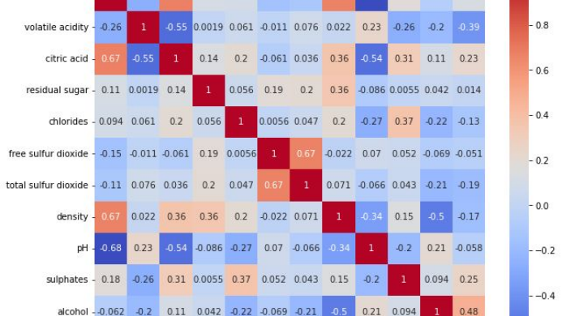
A heatmap correlation matrix gives the relation between different features. The features having negative values are less correlated to each other. The cells having dark blue color are weakly correlated, and cells having red color are strongly correlated.

Slide 8
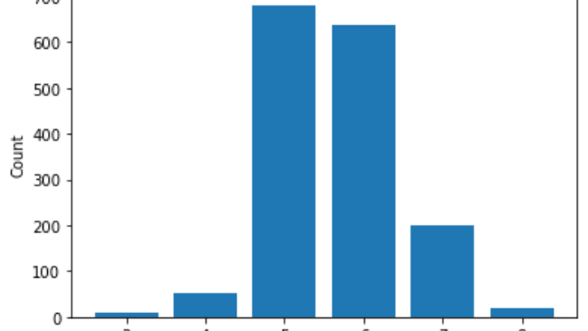
The quality ratings range from 3 to 8, with 3 being the lowest and 5 being the highest.
The distribution is not perfectly balanced, with a higher concentration of wines receiving ratings in the range of 5, 6, and 7.

Slide 9
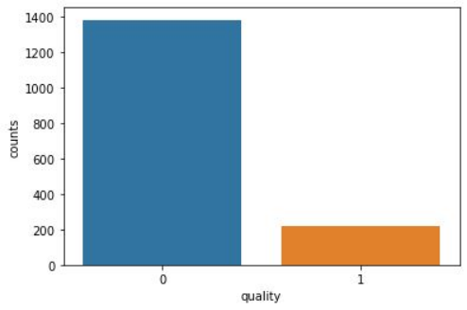
This plot has been generated by binning on the 'quality' column of the 'wine' Data Frame . The values of the quality of the wine between 2 and 6.5 will be labeled as 'bad', and values between 6.5 and 8 will be labeled as 'good'. By using Label Encoder object, which is used to convert the bin labels ('bad' and 'good') into numeric values. This step is necessary for certain machine learning algorithms that require numeric labels. This graph provides an overview of how many instances fall into each quality rating category. The bar plot provides insights into the distribution of instances across the different quality categories

Slide 10
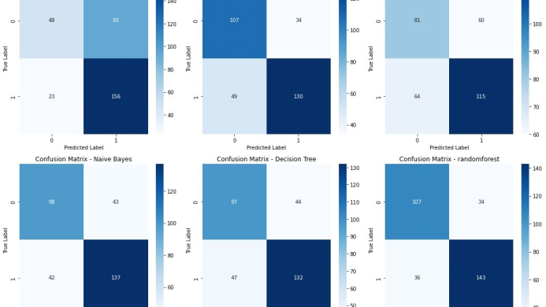
This graph was generated by performing the binary classification by converting the target variable into binary labels and it can be viewed by trains multiple classifiers, predictions on the test set was generated, and the confusion matrices was calculated and visualized with the help of heatmaps. The confusion matrices provide insights into the performance of each classifier in terms of correctly and incorrectly classified instances.

Slide 11
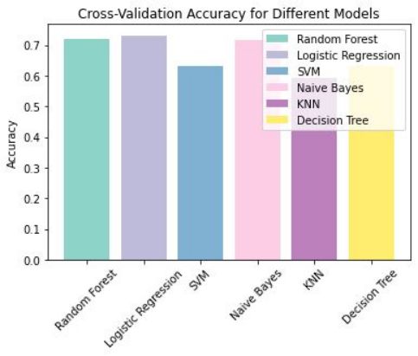
Cross-validation helps to obtain a more reliable estimate of a model's performance. By considering multiple subsets of the dataset, cross-validation reduces the bias and variance that may be present in a single train-test split, providing a more robust evaluation of the model's performance.

Slide 12
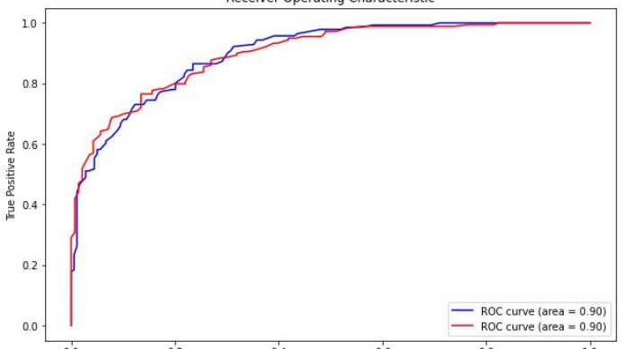
The ROC (Receiver Operating Characteristic) curve is a graphical representation used in machine learning to evaluate the performance of a classification model The ROC curve provides a visual representation of the performance of the RandomForestClassifier in distinguishing between different classes.

Slide 13
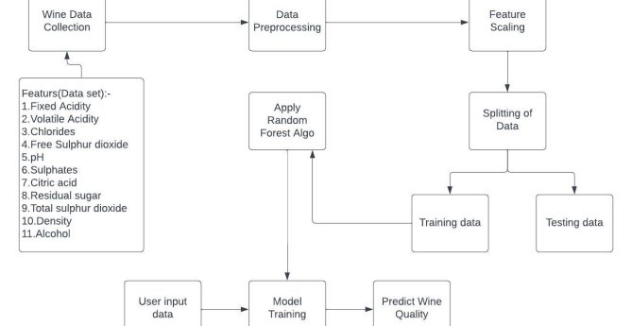

Slide 14
Conclusion The quality of the wine is a very important part for the consumers as well as the manufacturing industries. Industries are increasing their sales using product quality certification. Nowadays, all over the world wine is a regularly used beverage and the industries are using the certification of product quality to increases their value in the market. Previously, testing of product quality will be done at the end of the production, this is time taking process and it requires a lot of resources such as the need for various human experts for the assessment of product quality which makes this process very expensive. Every human has their own opinion about the test, so identifying the quality of the wine based on humans' experts it is a challenging task. There are several features to predict the wine quality, but the entire features will not be relevant for better prediction. The research aims to what wine features are important to get the promising result by implementing the machine learning classification algorithms such as Support Vector Machine (SVM), Naïve Bayes (NB), using the wine quality dataset. The algorithms, LR, RF, NB, DT ,SVM and NB give us the cross-validation accuracy of approximated to 73.1%, 72.1%, 71.7%, 63.2%, 63% and 59.2%. Amongst all Random Forest Algorithm (RF) gives us the best accuracy of 74% and with this algorithm we can predicted whether the quality of the wine is good or bad

Slide 15

REFERENCES [1] Hopfer, H., & Heymann, H., ”Judging wine quality: Do we need experts, consumers or trained panelists?,” Food Quality and Preference, 32, 2014, pp.221-233. [2] Sáenz-Navajas, M. P., Campo, E., Sutan, A., Ballester, J., & Valentin, D., “Perception of wine quality according to extrinsic cues: The case of Burgundy wine consumers,” Food Quality and Preference, 27(1), 2013, pp.44-53. [3] Gupta, Y., “Selection of important features and predicting wine quality using machine learning techniques,” Procedia Computer Science, 125, 2018, pp.305-312. [4] Freitas, A. A.: Data mining and knowledge discovery with evolutionary algorithms. Springer Science & Business Media, 2013. [5] Han, J., Pei, J., & Kamber, M.: Data mining: concepts and techniques. 3rd Edition. Elsevier, USA: Morgan Kaufmann, 2001. [6] Larose, D. T., & Larose, C. D.: Introduction to data mining and knowledge discovery. John Wiley & Sons, 1996. [7] Ponniah, P.: Data warehousing fundamentals: a comprehensive guide for IT professionals. John Wiley & Sons, 2004.

Slide 16

THANK YOU

